Slide 1
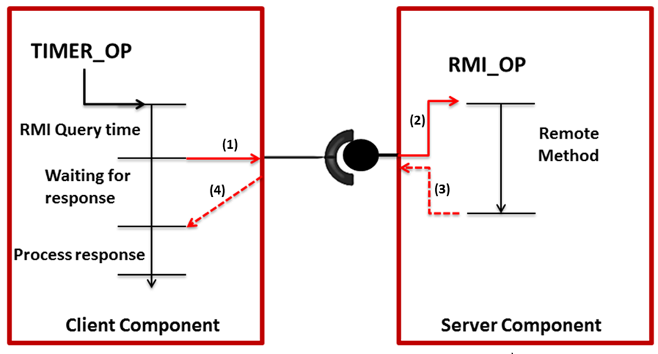
4 ms
12 ms
4 ms

Slide 2

TIMER_OP
RMI_OP
(2)
RMI
Query time
4 ms
Remote
Method
(1)
12 ms
Waiting for Response
(4)
(3)
Process Response
4 ms
CLIENT COMPONENT
SERVER COMPONENT

Slide 3

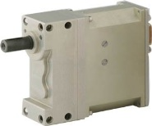
Data Acquisition Module
Main Controller
Sensor
Read
Publish Sensor Data
Control Loop
Receive Updated Sensor Data
Periodically read sensor data
IMU
15 ms
GPS
Perform Path planning and control calculations based on new sensor data. Prepare a control command for actuation
46 ms
Servo Actuator
Publish servo actuation command
Servo
Control
Control servos based on new requirements
Save state and prepare for next iteration
2 ms
8 ms

